Slide 1

Recruitment
VVF (India) Limited
Jan 23, 2014

Slide 2
RECRUITMENT STATUS
For CMB – QA position and Plant Head position:
QA – 4 Profiles downloaded yesterday. To forward to both Sunil and Akshay
PRF? Is Akshay aware
JD to be closed
Position Title : AGM
Interview to start with Akshay by 30th Jan. 2014
Position to closed by 15th Feb. 2014
Plant Head – 7 profiles forwarded to Sunil yesterday
PRF yet to be signed
Interview to start with Sunil by 30th Jan. 2014
Position to closed by 15th Mar. 2014

Slide 3
RECRUITMENT STATUS
GET – Next steps
GET attrition ppt. shared with Kakade. He has also asked this to be shared with all HODs. Archana to give detailed changes in curriculum for GETs basis discussion with Vinod by Friday w.r.t. job rotations.
Will do plant visit next week
Status of Finance position – Fresh CA, 2 contractual and 1 DGM Finance
Fresh CA – Campus only in Mar.
Discuss with Palo if we can wait till then or we hire a lateral with 1-2 years work exp.
2 contractual – 1 closed in Treasury and 1 short listed by Payal to meet Sundaresh.
To close pending by 31st Jan.
DGM Finance – By tomorrow profiles will be ready for interviewing with Amit
To close by 15th Feb 2014
EXIM – Shadow position of Ajay
Yet to start search
To send CVs to Sunil Menon by tomorrow EOD
Have person ready by 28th Feb. 2014

Slide 4

New Employee Connect
By Corporate Human Resources
Notes:
Change logo (top right) and page number (bottom right) placement across.

Slide 5

THE OBJECTIVE
To understand from newly joined employees their experiences at the time of joining till the first 90 days
To provide a platform to give your valuable feedback and share the same with the leadership team of VVF (India) Ltd.
To provide a mechanism to act on feedback and suggestions received from you and make improvements to the process
Forum for constructive areas that can be discussed in a group

Slide 6
FOCUS GROUP

Slide 7
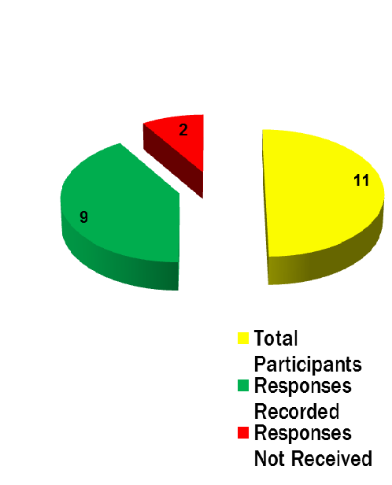
FOCUS GROUP
N = 11
Only 9 answered the question

Slide 8
KEY SECTIONS IN THE FEEDBACK FORM
Administration
Payroll
Induction & On – Boarding
KRAs & Goal Setting
Organization Culture

Slide 9
DATA ANALYSIS Administration: 1) Did you get the following on DOJ?
Attendance Card/Biometric
Cubicle/Cabin with keys to drawers and lockers

Slide 10
DATA ANALYSIS Administration: 1) Did you get the following on DOJ?
Visiting Cards
Telephone Extension List

Slide 11
DATA ANALYSIS Administration: 1) Did you get the following on DOJ?
Laptop/Desktop
Stationery

Slide 12
DATA ANALYSIS Administration:
You are satisfied with the relocation facilities (Initial stay in the guesthouse + Food), which the organization provided you during your initial days in VVF (India) Ltd.
The Admin team was helpful in explaining you the SOP for mobile bill reimbursement/mobile plan and Domestic or International Travel?

Slide 13
DATA ANALYSIS Administration:
Verbatim:
“Struggled a lot to get my family details to be incorporated on insurance policy record, too much delay occurred from admin department because of what my high value insurance claim is stuck due to action not taken in time & till the time it is pending”

Slide 14
DATA ANALYSIS Payroll:
You are satisfied with the way Payroll team helped you in opening a new Provident Fund Account or transferring your Provident Fund money?
You are satisfied with the information the Payroll team provided you about the office timings and working hours?

Slide 15
DATA ANALYSIS Payroll:
The payroll team informed you about the documents to be submitted for handling salary, and investments.?

Slide 16
DATA ANALYSIS Payroll:
Verbatim:
“Yes, one incident i faced is that on the day of september i failed to punch my card and after few days i have given the non-punching slip duly filled and signed but till the time salary was deposited by deducting one day pay. I have taken the matter with HR & have been ensured by HR that the same will be taken care in next month pay but next month after giving a reminder also the same was not deposited into my account. Again in third month the same thing has repeated after reminder the same neglected & then lastly i surrendered and quit.’’

Slide 17
DATA ANALYSIS Induction & Onboarding:
You are satisfied with the way your electronic on-boarding (e-mail creation & attendance card synchronization) was handled?
You are made aware about the canteen facility VVF provides and your canteen account was opened on the day of your joining.?

Slide 18
DATA ANALYSIS Induction & Onboarding:
All your bills with respect to your joining have been reimbursed and settled.
You are satisfied with the way Recruitment team conducted your induction.

Slide 19
DATA ANALYSIS Induction & Onboarding:
You were personally introduced to all your colleagues, sub-ordinates, managers in the organization.
You were assigned a reporting manager on the 1st day of your joining.

Slide 20
RECRUITMENT STATUS
Executive Assistant
Sources used:
ISB
IIM (PGX)
LinkedIn (1 candidate interested to be interviewed today
JD to be finalised. KPIs from Anuradha
To start interviews with Leadership team from 28th Jan
To close by 21st Feb with offer
Sourcing for Plant Head for Oleo
2 candidates (Mitul Seth –) / Vaibhav Mehrotra – To meet Vinod in 1st week of Feb
To close by 17th Feb 2014)
South Africa Finance position and Singapore position

Slide 21
RECRUITMENT STATUS
South Africa Finance position
Profiles sent to Rashmin.
No revert. Need to follow up
To close by March 31st 2014
Singapore position
Anh has declined the offer
Sourcing on – 2 candidates are interested via linkedIN
To close by 15th March 2014

Slide 22
RECRUITMENT STATUS (Closure dates)
Sr. No | Position Title | Closure by
1. | Plant Head - Baddi | 15th Mar. 2014
2. | DGM – Finance | 15th Feb 2014
3. | Shadow for Ajay | 28th Feb. 2014
4. | EA – MD | 21st Feb 2014
5. | Plant Head – Oleo | 17th Feb 2014
6. | Marketing - Singapore | 15th March 2014

